Slide 1
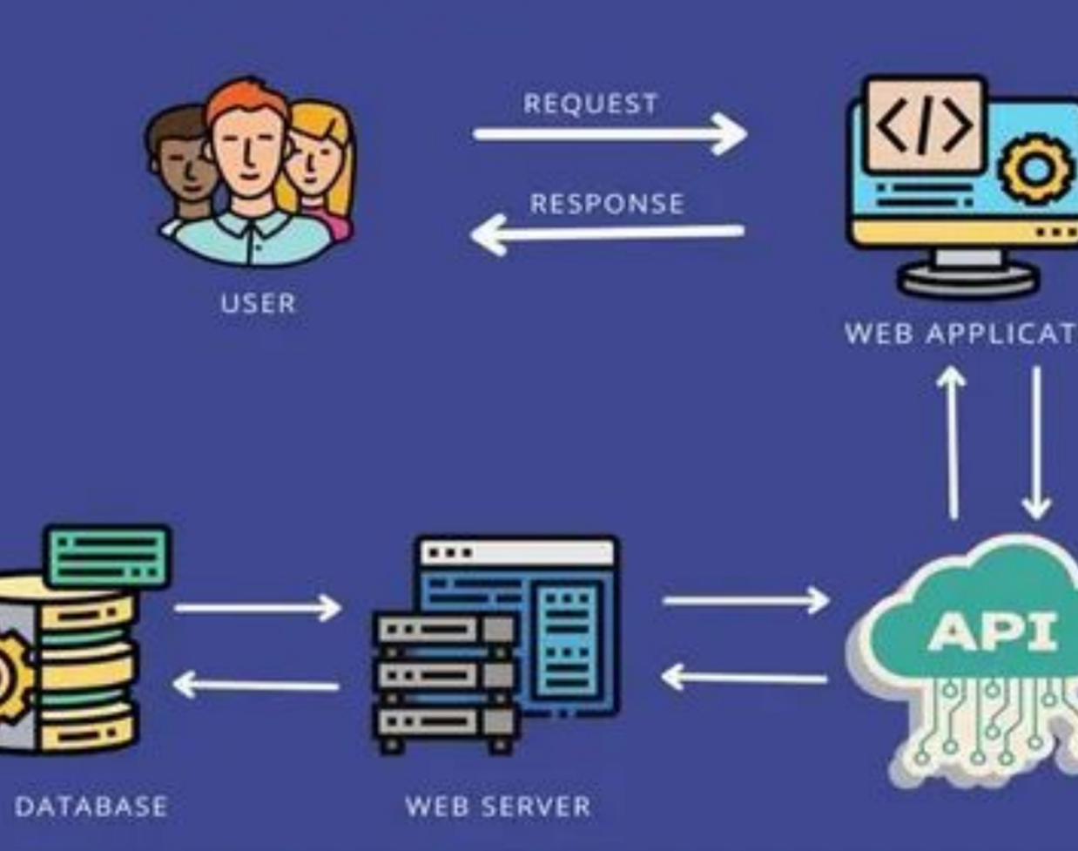
API
Application Programming Interface

Slide 2
API - Application Programming Interface
Application Programming Interfaces (APIs) are constructs made available in programming languages to allow developers to create complex functionality more easily.
They abstract more complex code away from you, providing some easier syntax to use in its place.
Eg: As a real-world example, think about the electricity supply in your house, apartment, or other dwellings. If you want to use an appliance in your house, you plug it into a plug socket and it works. You don't try to wire it directly into the power supply — to do so would be really inefficient and, if you are not an electrician, difficult and dangerous to attempt.

Slide 3
APIs in client-side JavaScript
Client-side JavaScript, in particular, has many APIs available to it — these are not part of the JavaScript language itself, rather they are built on top of the core JavaScript language, providing you with extra superpowers to use in your JavaScript code.
They generally fall into two categories:
Browser APIs
Third-party APIs

Slide 4
Browser APIs
It are built into your web browser and are able to expose data from the browser and surrounding computer environment and do useful complex things with it.
APIs for manipulating documents loaded into the browser.
APIs that fetch data from the server to update small sections of a webpage
APIs for drawing and manipulating graphics are widely supported in browsers
Audio and Video APIs
Device APIs enable you to interact with device hardware
Client-side storage APIs enable you to store data on the client-side

Slide 5
Third-party APIs
Third-party APIs are not built into the browser by default, and you generally have to retrieve their code and information from somewhere on the Web.
For example, the Twitter API allows you to do things like displaying your latest tweets on your website.
It provides a special set of constructs you can use to query the Twitter service and return specific information

Slide 6
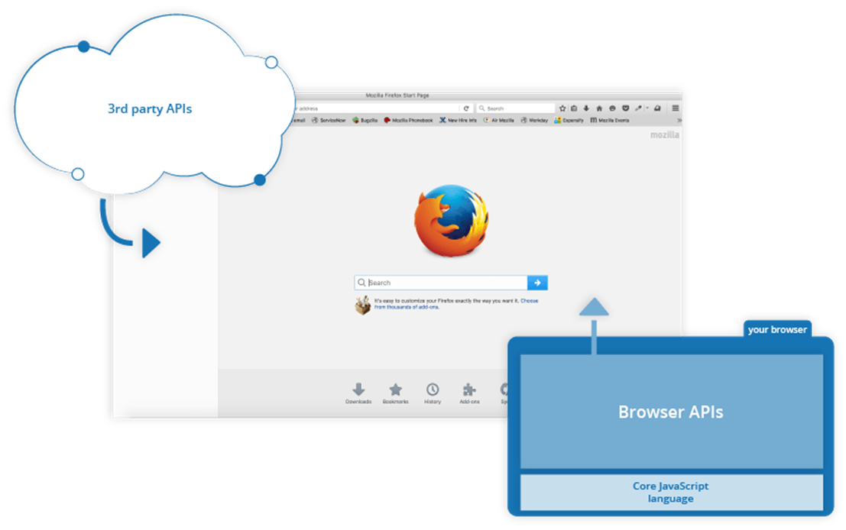

Slide 7
Third-party APIs
Twitter API - which allows you to do things like displaying your latest tweets on your website.
Map APIs - which allow you to do all sorts of things with maps on your web pages.
Telegram APIs - which allows you to embed content from Telegram channels on your website, in addition to providing support for bots.
YouTube API - which allows you to embed YouTube videos on your site, search YouTube, build playlists, and more.

Slide 8
Benefits Of Using API
APIs needed to make the connection between application functions to handle the data from predefined processes
Easy of Integration: APIs can be embedded with any type of software application, so it can be easily integrate with the applications and functions between different websites

Slide 9
Working with APIs in JavaScript
An API is simply a medium to fetch or send data between interfaces.
Some real-time data fetched from the server or maybe even allows you to modify or add data to some other endpoint. This is made possible by the API or the Application Programming Interface

Slide 10
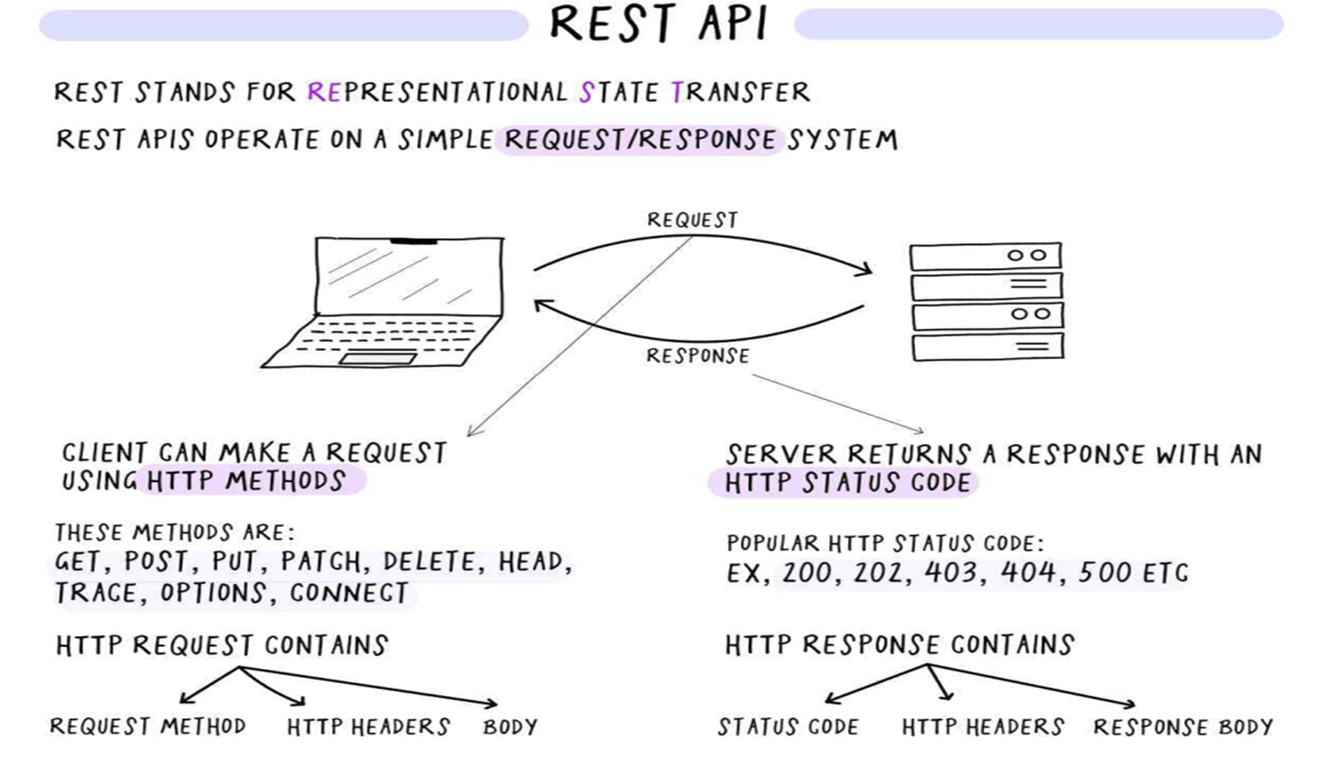

Slide 11
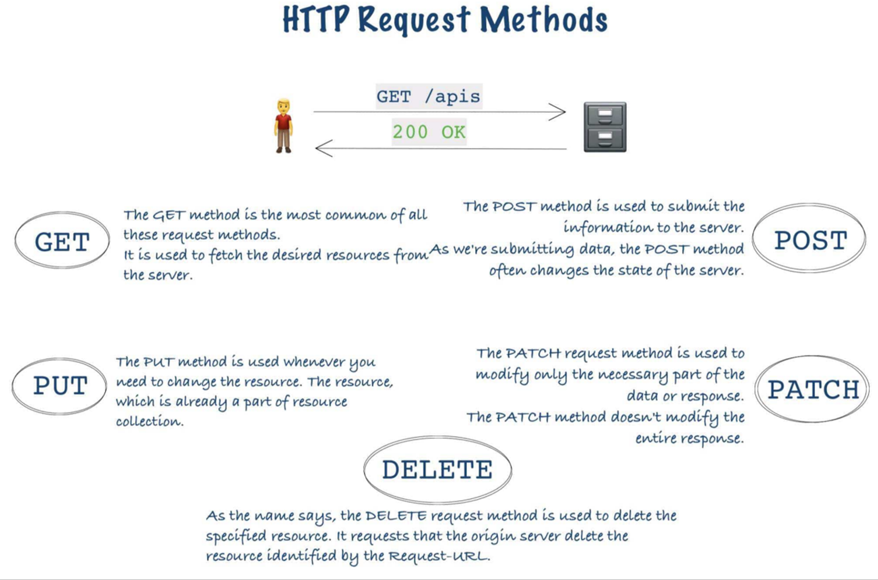

Slide 12
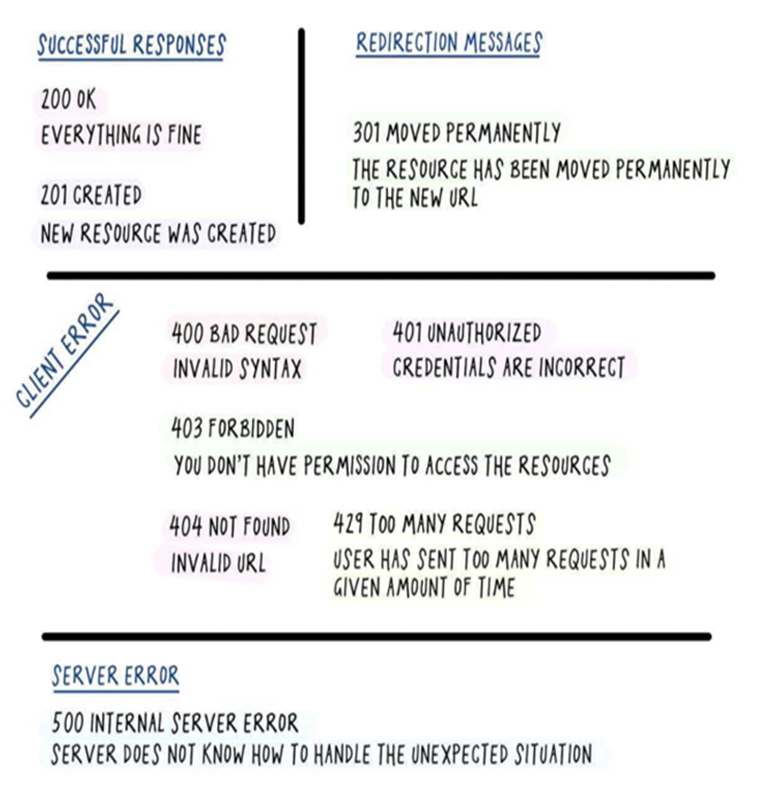
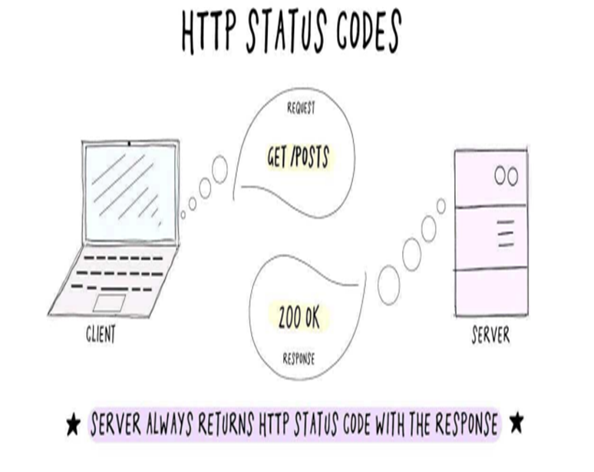

Slide 13
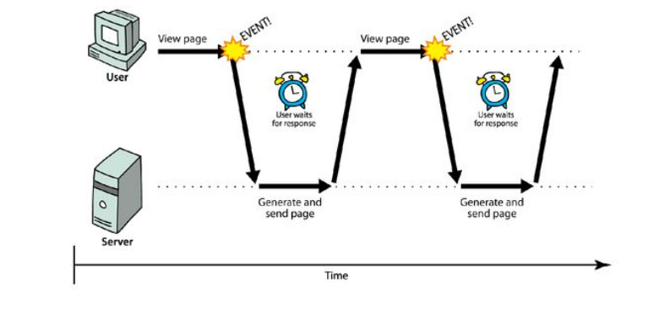
Synchronous Web Communication

Slide 14
Synchronous Web Communication
User must wait while new pages load
The typical communication patter used in web pages (click,wait,refresh)
As the name suggests synchronous means to be in a sequence, i.e. every statement of the code gets executed one by one. So, basically a statement has to wait for the earlier statement to get executed.
This can lead to blocking behavior, where the execution of subsequent code is delayed until the current task is finished.
Eg: console.log("Task 1");
console.log("Task 2");
console.log("Task 3");

Slide 15
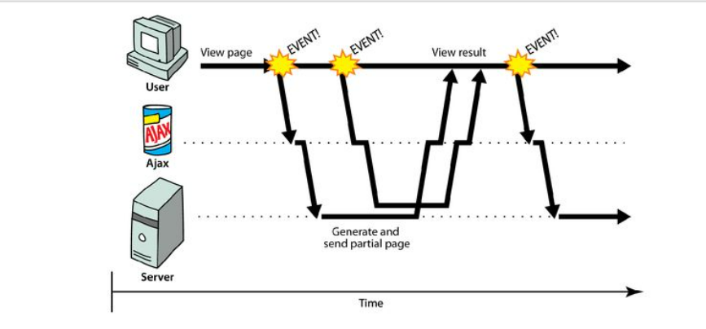
Asynchronous Web Communication

Slide 16
Asynchronous Web Communication
In asynchronous JavaScript, tasks are executed independently of the main program flow.
When an asynchronous task is encountered, it is initiated and the program continues to execute without waiting for it to complete.
Callback functions or promises are typically used to handle the result of asynchronous tasks when they finish executing.
Asynchronous JavaScript is particularly useful for tasks that might take some time to complete, such as fetching data from a server, reading files, or waiting for user input. It allows the program to continue executing other tasks without being blocked by long-running operations.

Slide 17
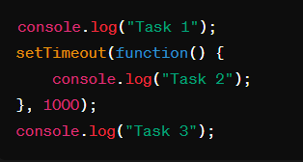
Eg:

Slide 18
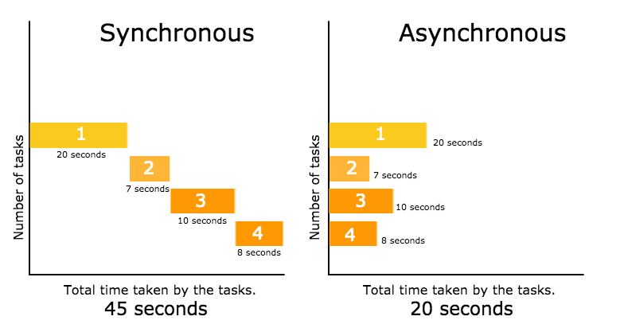

Slide 19
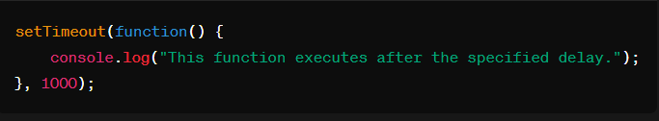
Callback Functions
A callback function is a function that is passed as an argument to another function, to be “called back” at a later time.
A function that accepts other functions as arguments is called a higher-order function, which contains the logic for when the callback function gets executed.
It’s the combination of these two that allow us to extend our functionality.
Eg:

Slide 20
AJAX
Asynchronous Javascript And Xml

Slide 21
AJAX
AJAX is not a programming language.
AJAX just uses a combination of: A browser built-in XMLHttpRequest object (to request data from a web server) JavaScript and HTML DOM (to display or use the data)
Ajax is just a means of loading data from the server and selectively updating parts of a web page without reloading the whole page.
Basically, what Ajax does is make use of the browser's built-in XMLHttpRequest (XHR) object to send and receive information to and from a web server asynchronously, in the background, without blocking the page or interfering with the user's experience.
The example of some large-scale Ajax-driven online applications are: Gmail, Google Maps, Google Docs, YouTube, Facebook, Flickr, and so many other applications.

Slide 22
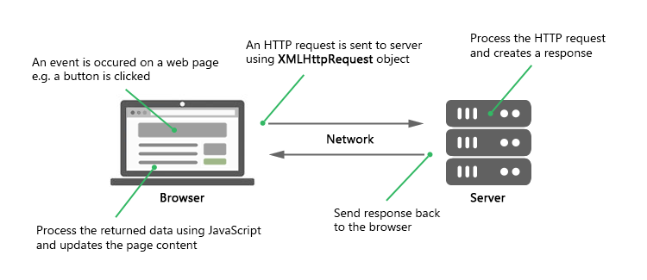

Slide 23
Memory Management in JavaScript

Slide 24
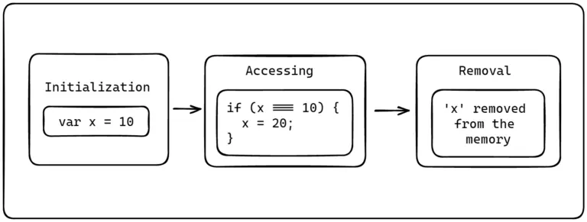
Memory life cycle in JavaScript
The memory life cycle defines a JavaScript variable or object’s journey from initialization to removal. JavaScript and all the other programming languages have a similar memory life cycle, as depicted below.

Slide 25
How does JavaScript store variables?
Where do these allocations and deallocation happen?

Slide 26
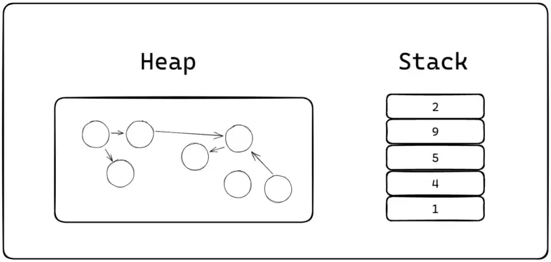
How does JavaScript store variables?
Where do these allocations and deallocation happen?

Slide 27
Stack
JavaScript uses the stack data structure to store static or fixed-size data.
It includes all numbers, strings, booleans, and other primitive data types.
These data types have a fixed size known at compile time.
Variables such as objects, arrays, etc., are not stored in the stack as their size varies during run time.

Slide 28
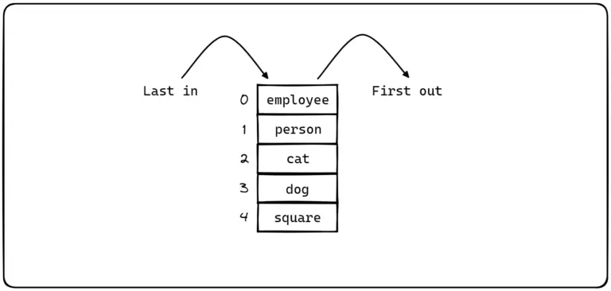

Slide 29
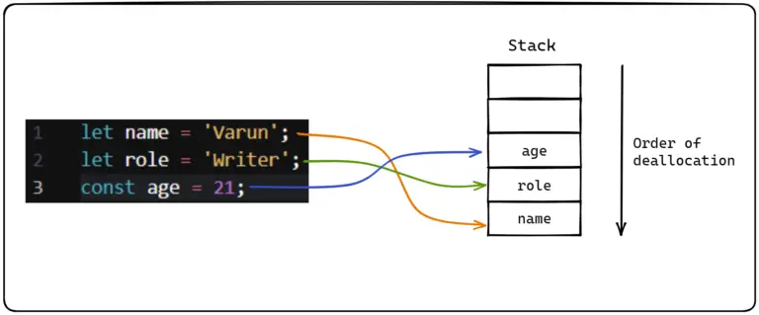

Slide 30
Heap
JavaScript uses a heap for storing variables whose size is unknown at compile time or may vary at the run time, such as objects, arrays, functions, etc.
The JavaScript Engine dynamically allocates memory to the heap. Initially, the heap size depends on available system memory, and it can be dynamically increased/decreased based on the need.

Slide 31
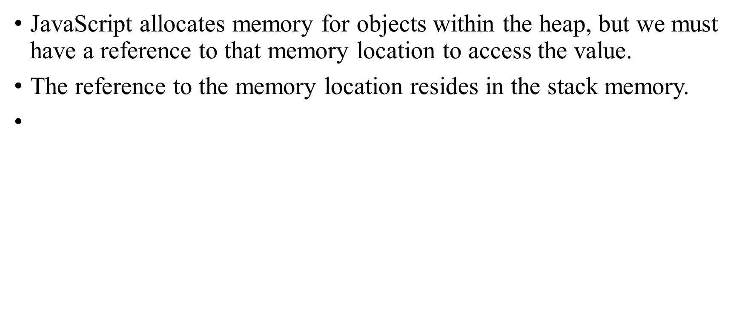
Values and references

Slide 32
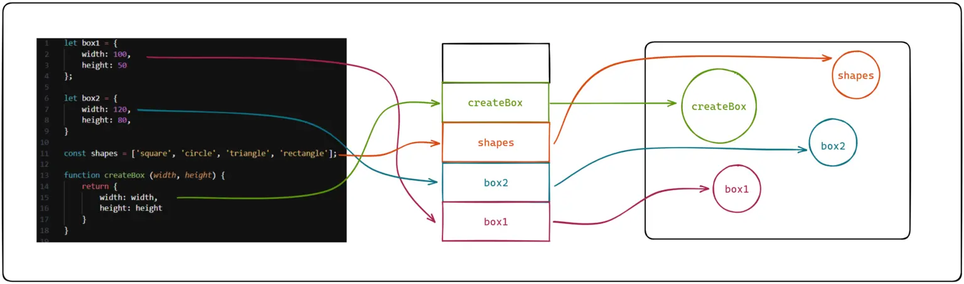

Slide 33
Stack Overflow
When the function runs inside and inside, the call stack will be filled and overflows.
When the stack overflows, Maximum call stack size exceeded error will be thrown.
The below function runs inside and inside and the stack will be overflowed.
Ex: function inception() {
inception();
}
inception();

Slide 34
Garbage Collection
JavaScript automatically cleans out the memory allocated to the data after its execution.
For example when the memory allocated for the variable created inside the function, it will be cleared after the function execution automatically.
It will manages the memory leaks.
It will automatically controls the memory heap.
It follows Mark and Sweep algorithm to handle Garbage collection.

Slide 35
Memory Leaks
Memory leaks occurred when the data is overloaded (Infinite data into an array), it breaks the browser.
Ex: let array = [];
for(let i=1; i>0; i++) {
array.push(i);
}

Slide 36
Call Stack
The Call Stack is a part of the JavaScript Engine and it is simply a stack in which you can add an item and the item added first is processed last.
In other words, it follows the FILO - 'First In Last Out' principle.
A Call Stack acts as a placeholder or a holding area for all the JavaScript functions that have been fired for execution.

Slide 37
What is Event Loop in JavaScript?
The event loop is a fundamental concept in JavaScript for managing asynchronous operations.
It's a mechanism that allows JavaScript to handle tasks such as timers, I/O operations, and event handling in a non-blocking manner, ensuring smooth and responsive behavior in web applications.
following components that constitute Event Loop Architecture.
1 The Call Stack
2 Web API
3 Event Queue

Slide 38
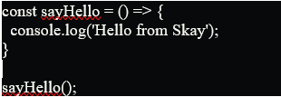
Call Stack
Let us look at the below code sample and understand how the function 'sayHello' gets added to the Call Stack.

Slide 39
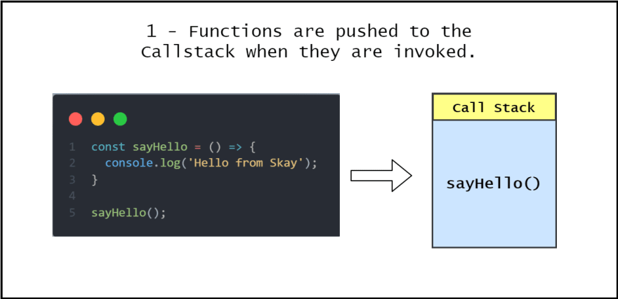
Step 1 - sayHello Function gets added to the Call Stack

Slide 40
Step 2 & 3 - Function returns a value & gets popped from the Call Stack
Once the function returns a value, the output 'Hello from Skay' gets displayed on the console. As soon as the function returns, almost immediately, the function is also popped off from the call stack.

Slide 41
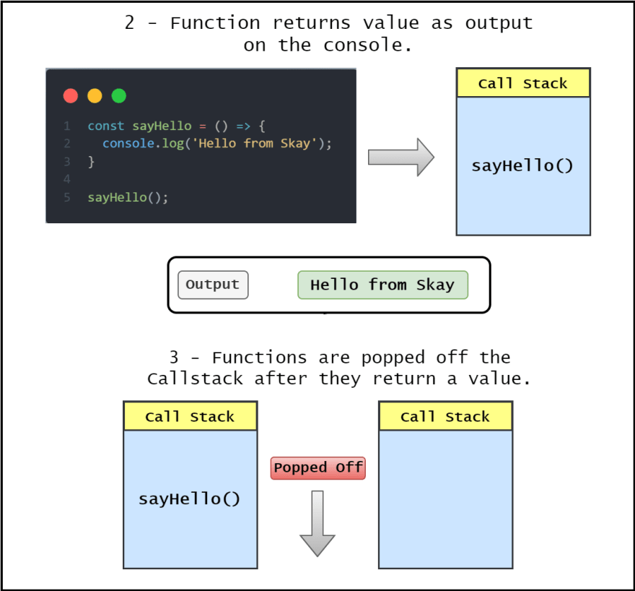

Slide 42
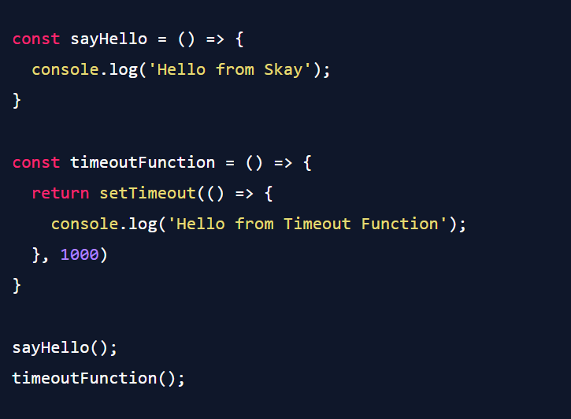

Slide 43
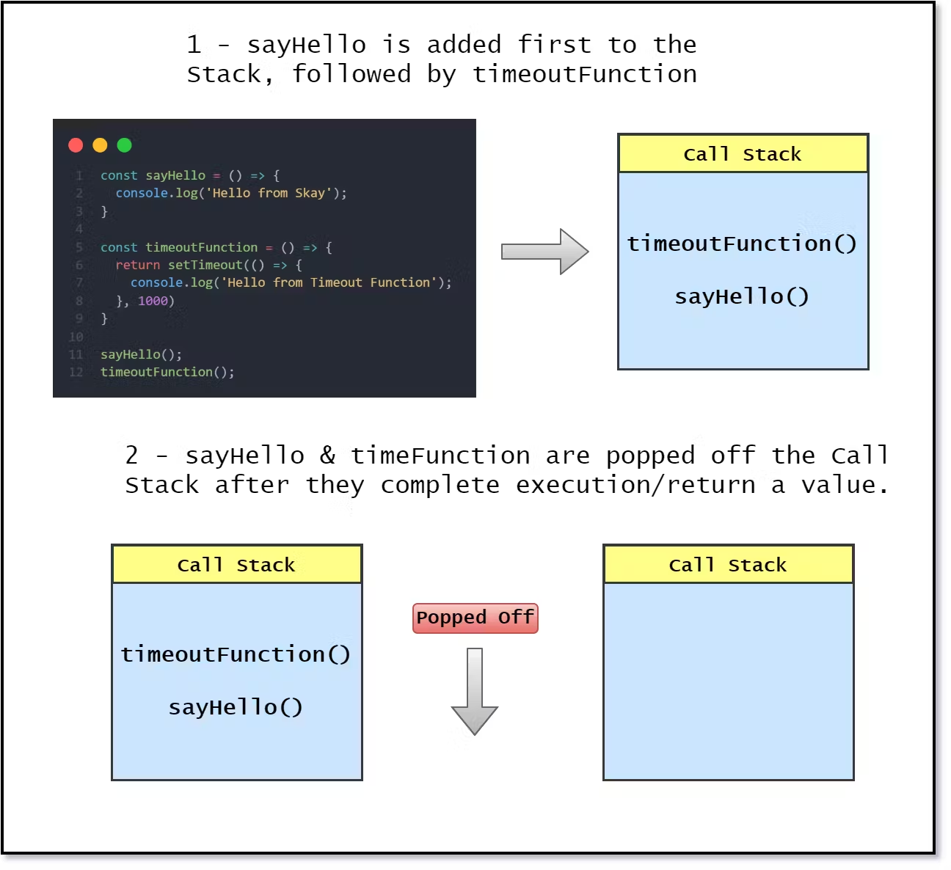

Slide 44
Web API
Web APIs are built into your web browser and they are able to process data from the browser to do complex useful things. The main thing to understand is that, they are not a part of the JavaScript language, but, they are built on top of the core JS language and provide much more capabilities such as Geolocation, localstorage, etc.

Slide 45
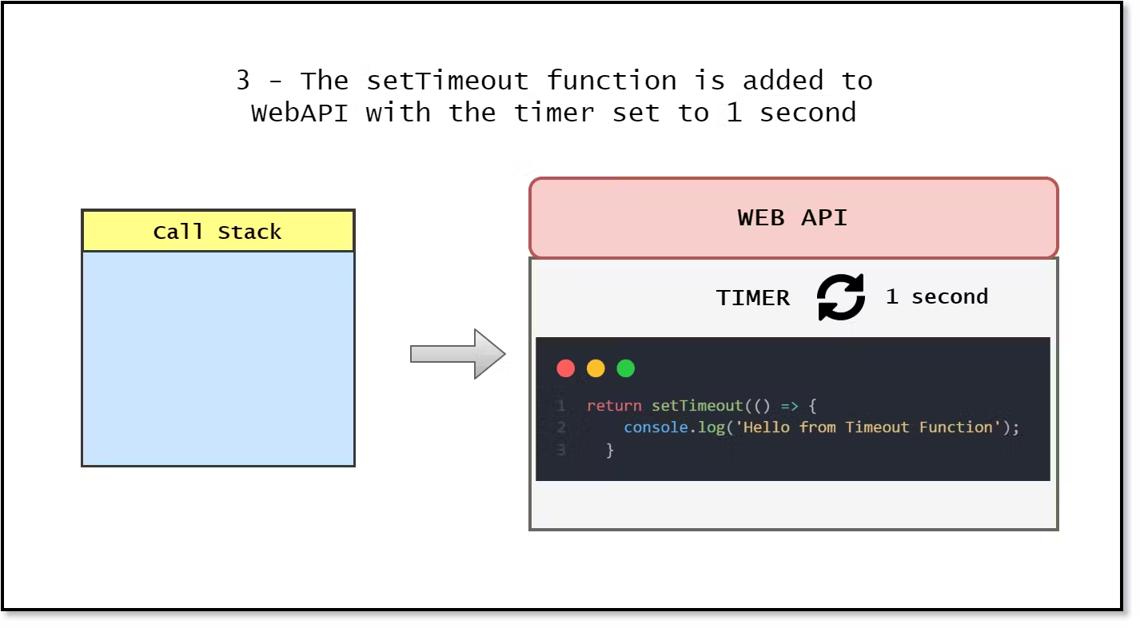

Slide 46
Event Queue
Event Queue is a data structure similar to Stack, which holds the data temporarily and the important thing to note is that the data added first is processed first. In other words, it follows the FIFO -> 'First in First out' principle.

Slide 47
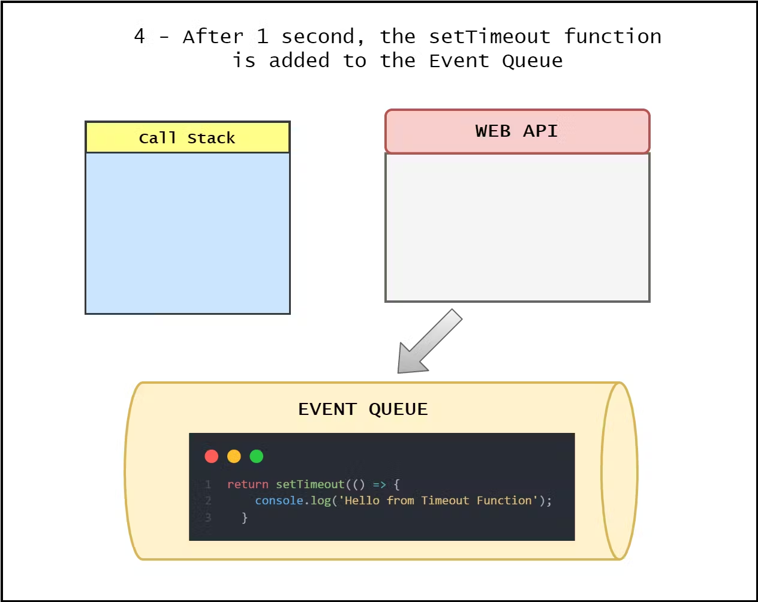

Slide 48
Event Loop
Finally, the 'Event Loop' we've been waiting for. The function of Event Loop can simply be explained as connecting the Event Queue to the Call Stack.

Slide 49
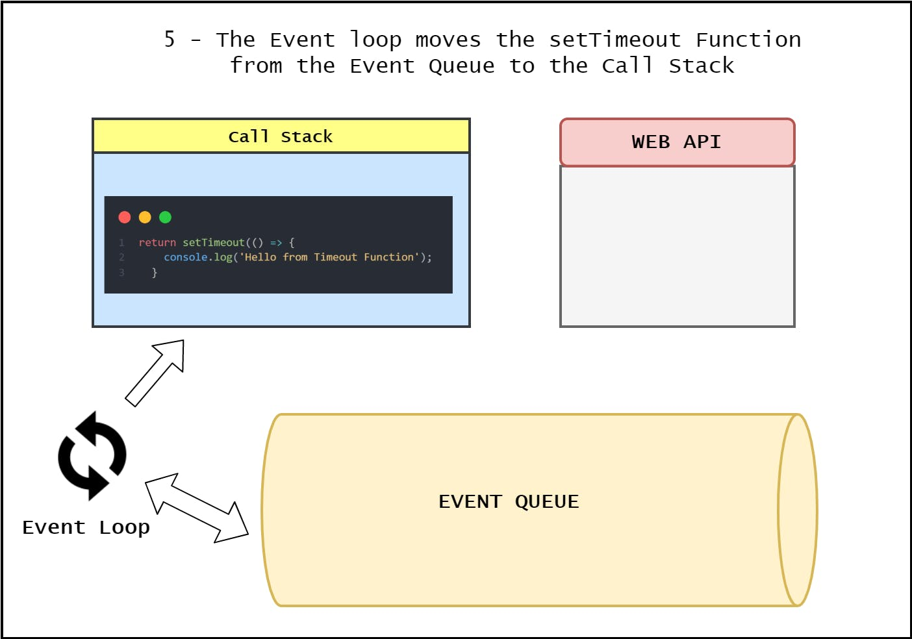

Slide 50
Event Loop does the following:
Checks if the Call Stack is empty, i.e., if all the functions have completed their execution and they have been popped off the Call Stack.
Once the Call Stack is empty, it moves the first item from the Event Queue to the Call Stack.

Slide 51
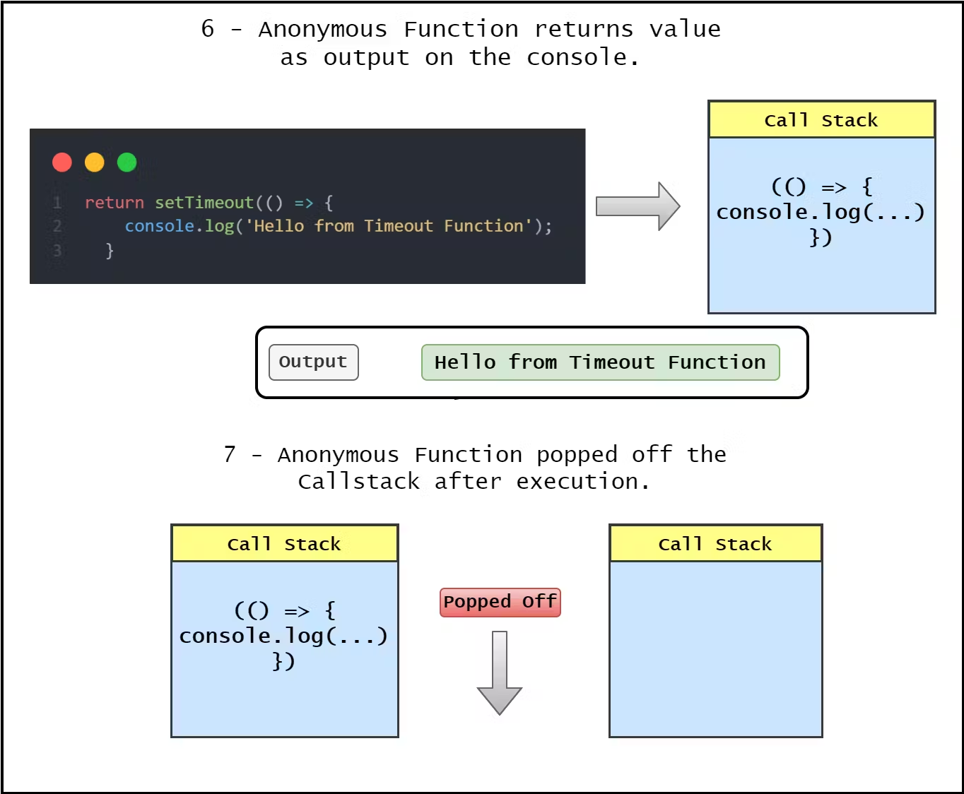

Slide 52
